Slide 1
Phonics Workshop
17.10.2024

Slide 2
What is phonics?
Phonics is a method for teaching reading and writing.
It develops phonemic awareness – the ability to hear, recognise and use the sounds within words.
Learners are also taught the correspondence between sounds and the graphemes (spelling patterns) that represent them.
Children will also be taught other skills, such as whole-word recognition (see ‘tricky words’), book skills, comprehension and a love and enjoyment of reading.

Slide 3
Did you know?
The English language has:
26 letters
44 sounds
over 100 ways to spell those sounds
It is one of the most complex languages to learn to read and spell.

Slide 4
terminology
Phoneme – the smallest unit of sound to represent a letter.
Grapheme – a letter or group of letters representing one sound
Blend/Blending – to draw individual sounds together to pronounce a word e.g. s-n-a-p blends together and reads snap. Used to read words.
Segment/Segmenting – to split a word into its individual phonemes in order to spell..
Tricky words – words that are not phonetically de-codable
Stoke Gabriel Primary School - Parent Guides/ FAQ (thelink.academy)
VC vowel consonant words e.g. in, on, up
CVC consonant, vowel, consonant words e.g. cat, sit, hop, zip
Comprehension – understanding the story and what they are reading
Fluency – reading without sounding out words

Slide 5
Pure sounds
Pure sound in phonics is the pronunciation of each letter sound clearly and distinctly without adding additional sounds to the end. An understanding of pure sounds will help children to blend and segment words.
When pronouncing phonics sounds, it’s important to pronounce them phonetically without adding anything extra to the end. This is called a ‘schwa’. This is one of the most common mistakes that people make with phonics pronunciation.
Pure sounds are a crucial part of learning phonics pronunciation. Being able to sound out pure sounds for letters such as 'f', 'm', and 's' as 'ff', 'mmm' and 'sss' makes it much easier for children to blend sounds together to read.
https://youtu.be/BqhXUW_v-1s?si=deOEuNwsISfpQL2d

Slide 6
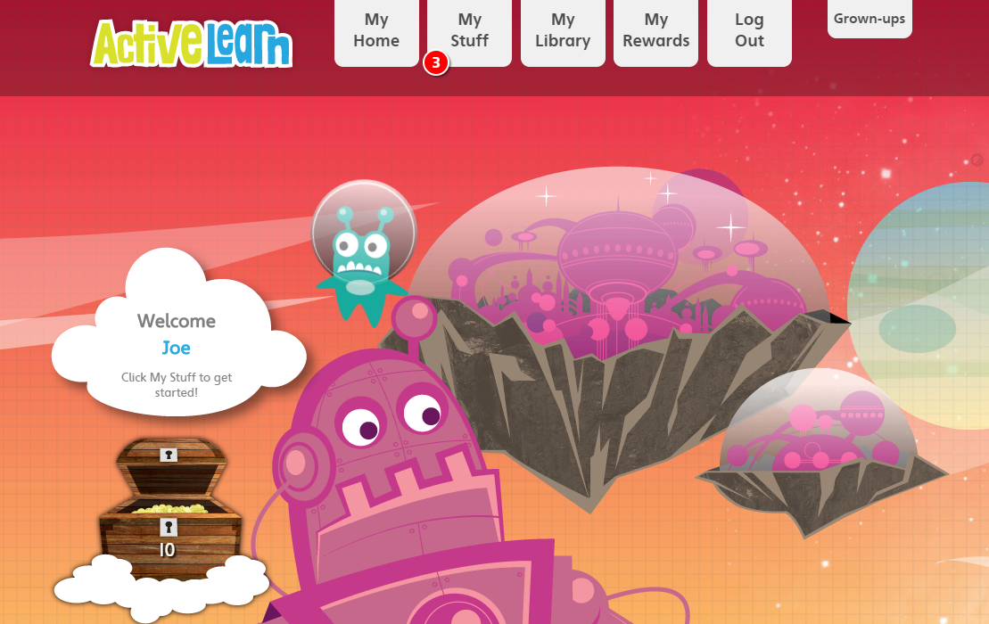
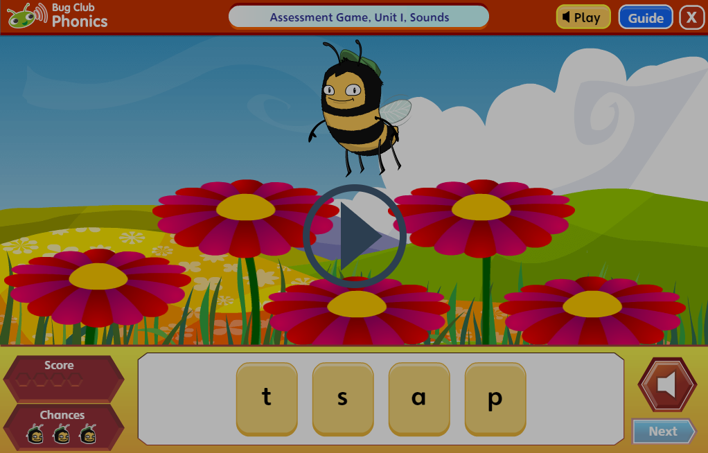
How you can support at home
Practice phonemes and tricky words
Read your child's book. Read the front cover of the book with the focus sounds, words and tricky words.
Bug Club online – there are additional books and games to support your child's phonics journey.
Capital letters/lowercase letters
Bingo
Tricky word hunt
Splat the tricky word
Board game
Stepping stones/Puddle jumping

