Slide 1
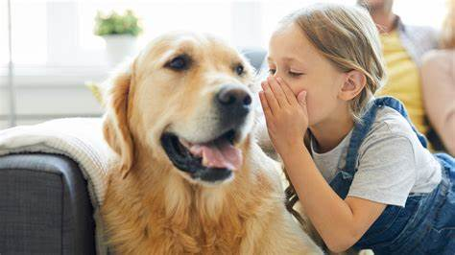
Talk Tuesday
Would you rather that pets could talk to you or that you could understand what their barks, chirps and meows mean?
Sentence stems
I would rather … because …
Another reason would be …
I agree with …. because …
I disagree with …. because …
I understand your viewpoint however …

Slide 2
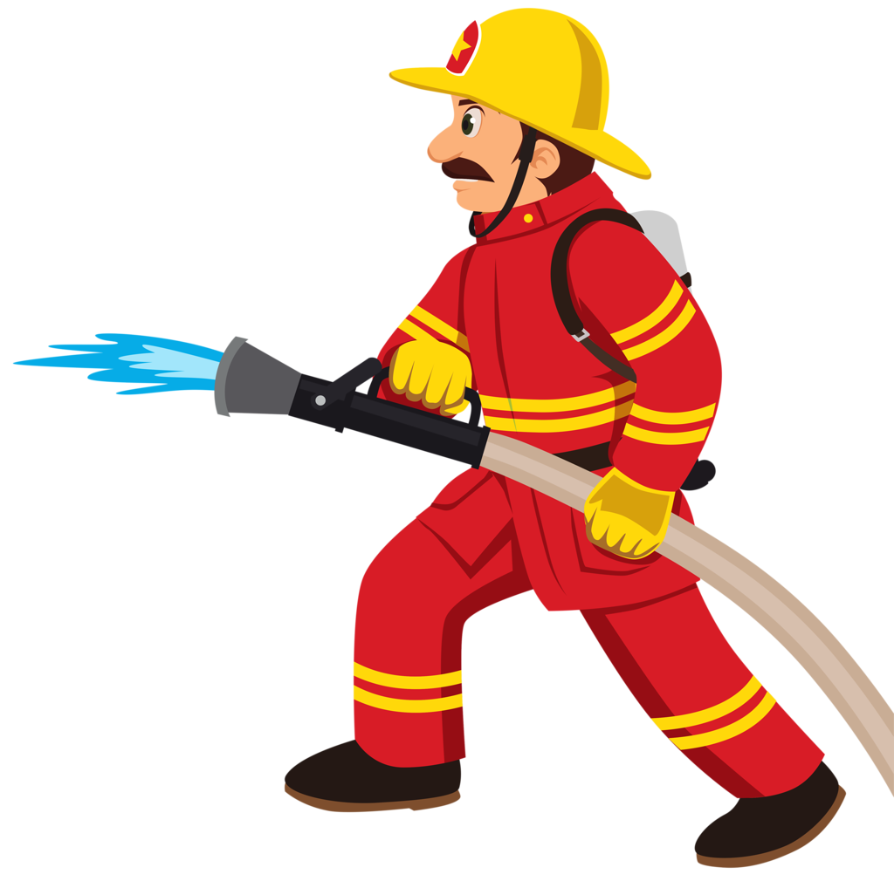
Would you rather be a fire fighter or a police officer?
Sentence stems
I would rather … because …
Another reason would be …
I agree with …. because …
I disagree with …. because …
I understand your viewpoint however …

Slide 3
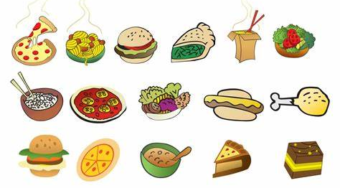
If you could only eat the same meal every day for the rest of your life, which would you choose and why?
Sentence stems
I would choose … because ….
In addition, ….
I value your reasoning but …
Have you thought about … ?
Can you include any of this tier three vocabulary?
Carbohydrate
Protein
Fibre
Dairy
Fats and oils
Fruit and vegetables
Can you include any tier 2 vocabulary in your talk?
appetising
savoury
mouth-watering
exquisite
heavenly
divine

Slide 4
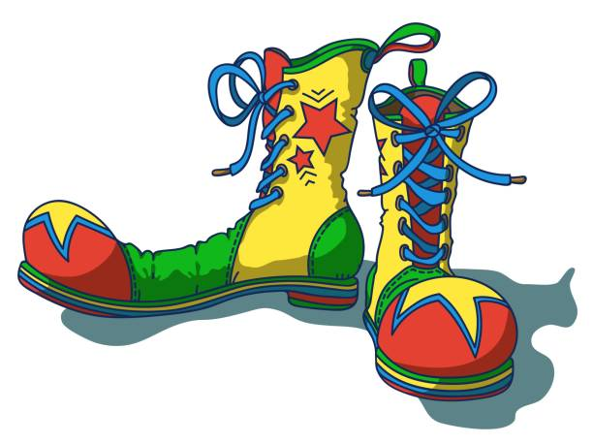
Would you rather wear clown shoes every day or a clown nose every day?
Sentence stems
I would rather … because …
I agree with your point about ….
I disagree with your point about …
Have you considered ….?

Slide 5
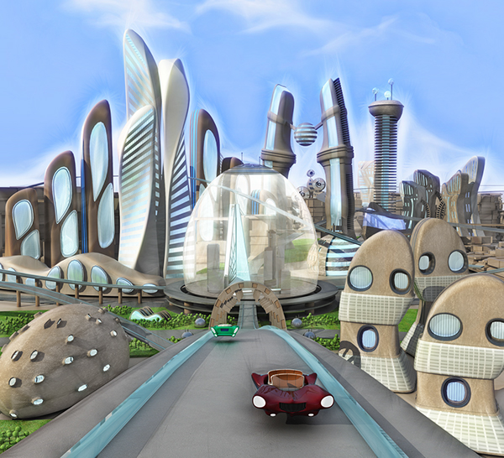
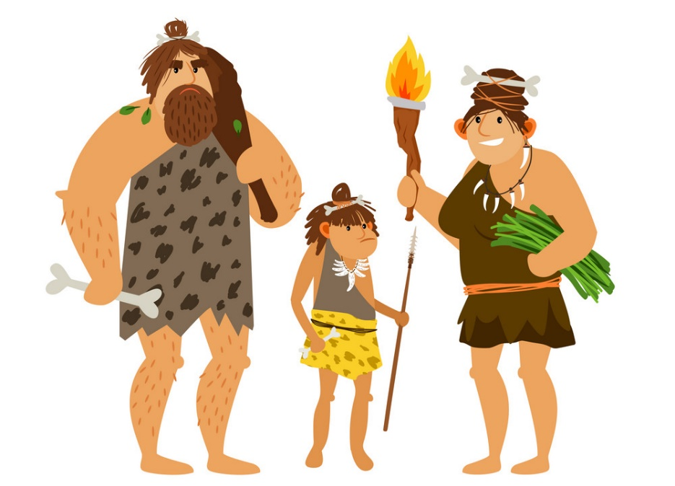
Would you rather travel to the past or to the future?
If you chose the past, which time in the past would you travel to and why?
Sentence stems
I would rather … because …
I love your idea about …. however …
Alternatively, …
I would like to add that …

Slide 6
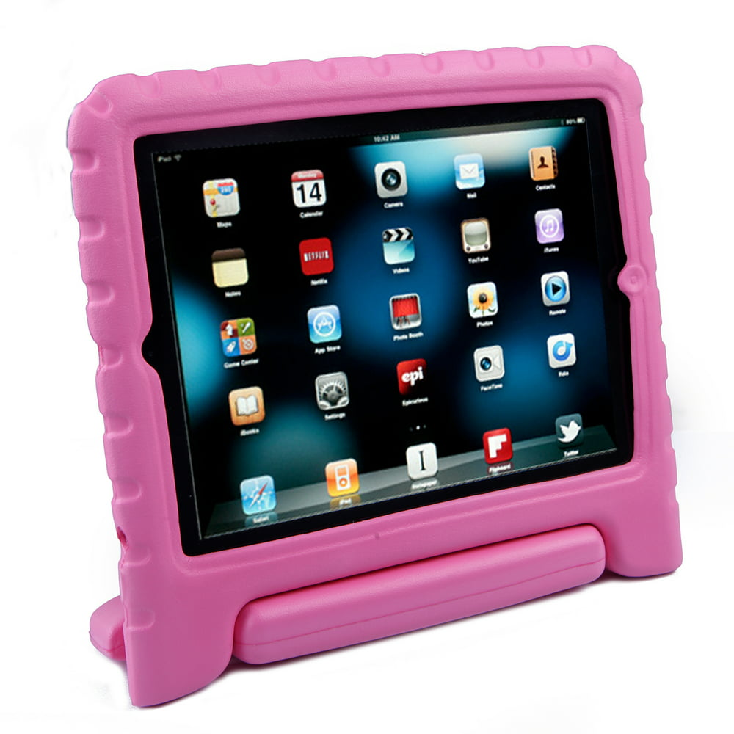
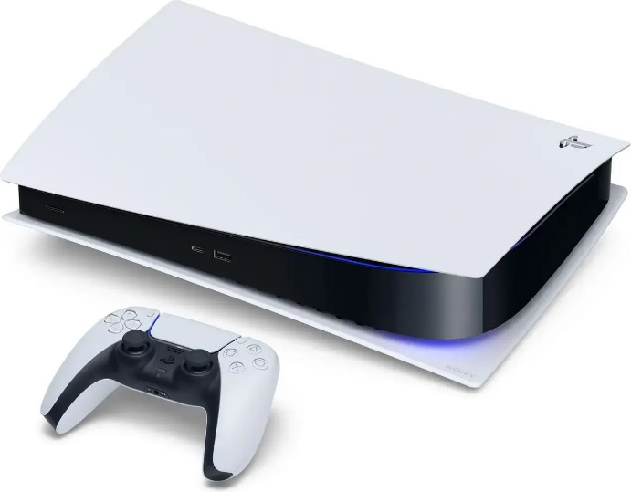
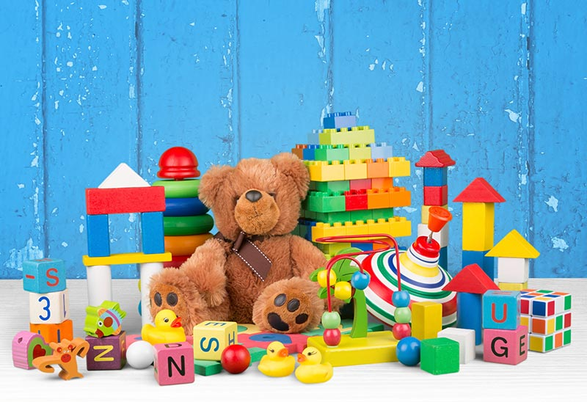
‘Having more ‘things’ make us happier’
Do you agree?
Sentence stems

Slide 7
Should Halloween be celebrated?
Sentence stems
I believe that Halloween should be celebrated because …
To add to this …
I do not believe that Halloween should be celebrated because …
Another reason would be …
I understand your viewpoint but …
Get someone to extend your talk:
Can you give another example of …
Can you tell me more about … ?
Have you thought about … ?

Slide 8
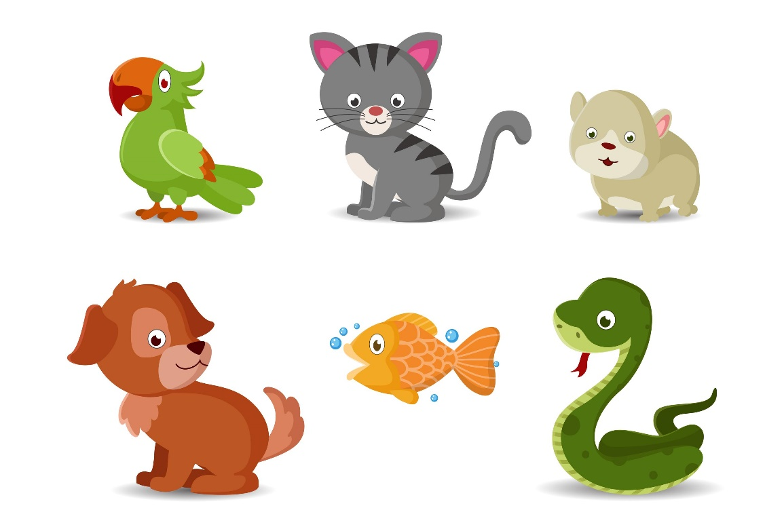
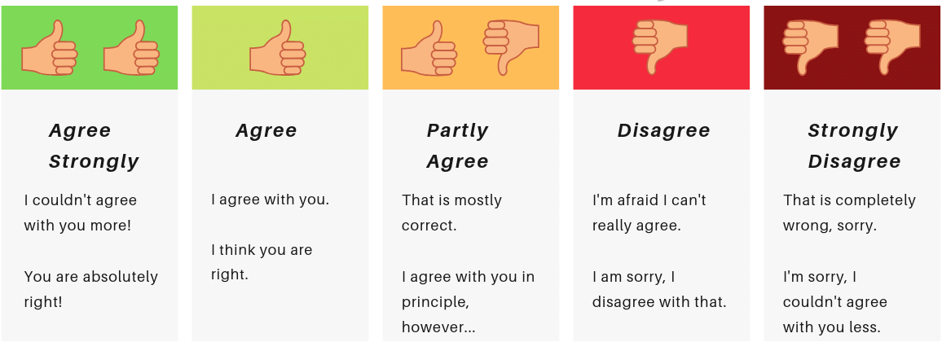
‘Every class should have a pet’.
How far do you agree?
Sentence stems
I strongly/ mostly/ somewhat/ partly agree because …
I strongly/ mostly/ somewhat/ partly disagree because …
In addition, …
On the other hand …
Alternatively …

Slide 9
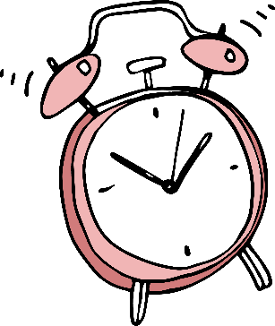
Is it our job to take care of the environment?
Sentence stems
It is our job to look after the environment because …
I also believe that …
To add to my point …
I hear your opinion but …
Vocabulary to use in your discussion
Endangered species littering energy
Recycling disasters landfill
Global warming government emissions
Activists public
Fuel climate change
Greenhouse gases deforestation
2 minute challenge – set your timer
Can you talk about this topic non-stop for 2 minutes?
How many pieces of the vocabulary can you use in your talk?

Slide 10
‘Weekends should be three days long.’
What is your opinion?
Can you persuade someone to agree with you?

Slide 11
‘The internet should be banned in school.’
Sentence stems
I strongly/ mostly/ somewhat/ partly agree because …
I strongly/ mostly/ somewhat/ partly disagree because …
In addition, …
On the other hand …
Alternatively …

Slide 12
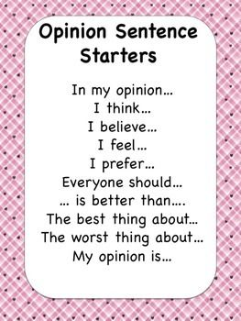
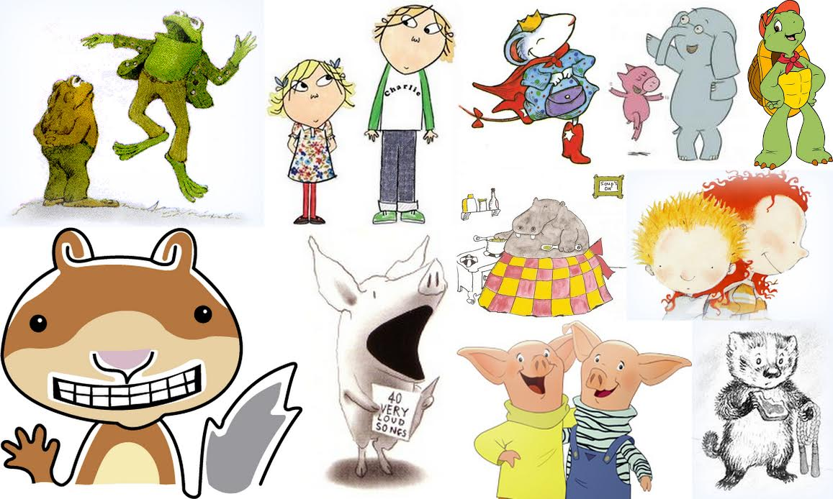
If you could hop into a book, which character would you become and why?

Slide 13
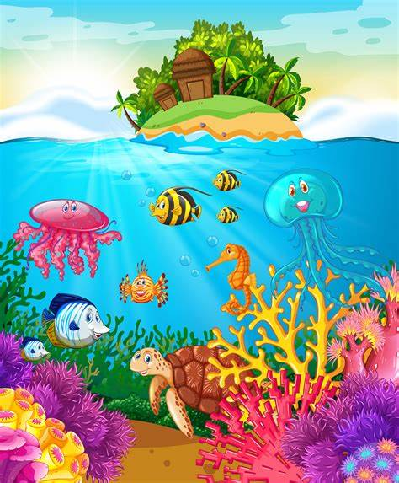
Would you rather live at the very top of a mountain or the very bottom of the sea?
Explain your reasoning – can you convince someone to agree with you?
Sentence stems
I would rather … because …
I agree with x because ….
I disagree with x because ….
The point about x was important …
Despite disagreeing with ….. I agree with the point about …
I see your point however ….

Slide 14
Do you have to win to be successful?
Sentence stems
I think that … because …
In addition …
To add to my point …
Building on this further …
Furthermore …
On the other hand …

Slide 15
Sentence stems
‘Teachers can be replaced with computers.’
Sentence stems

Slide 16
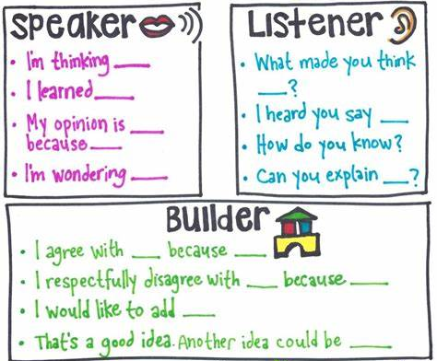
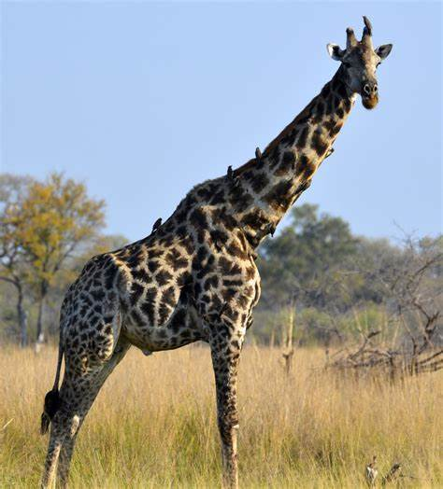
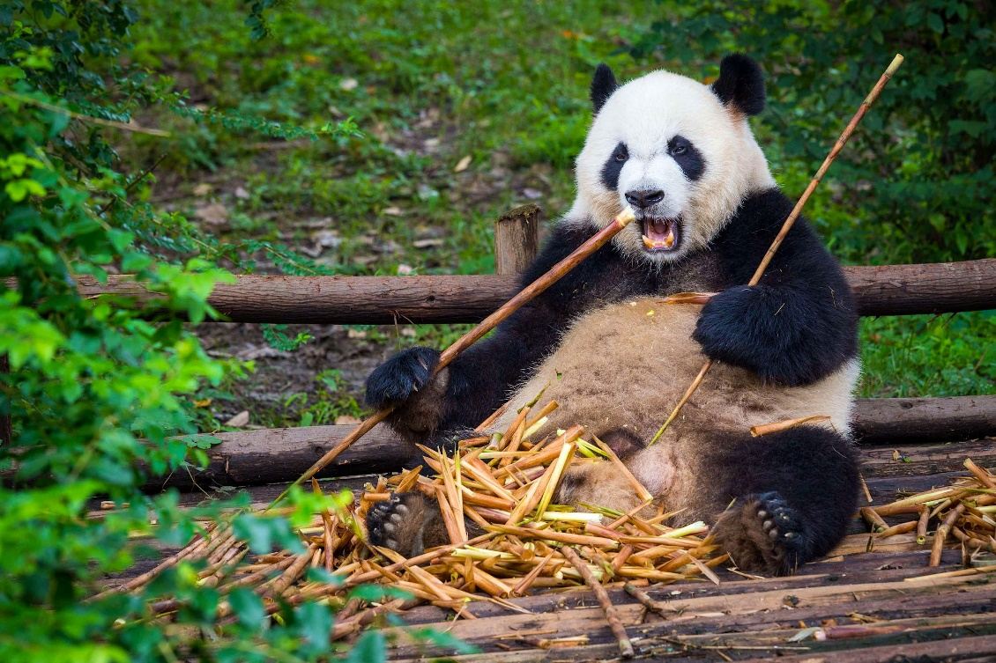
Would you rather have a pet giraffe or a pet Panda?
Sentence stems

Slide 17
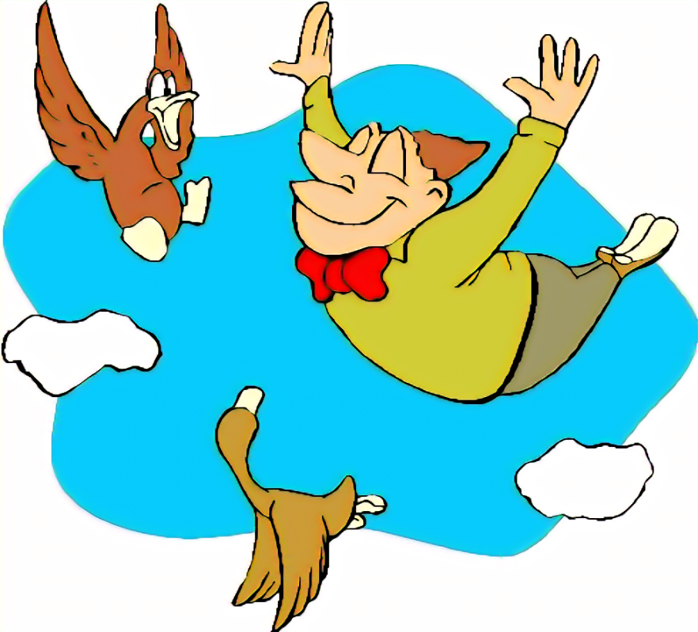
Would you rather be able to fly or read minds?
Sentence stems

Slide 18
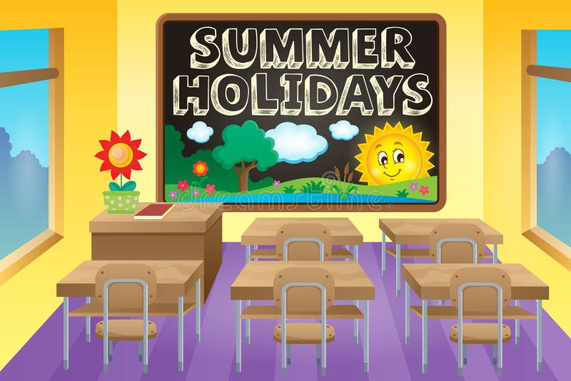
‘School holidays should be longer.’
Sentence stems
Sentence stems
I strongly/ mostly/ somewhat/ partly agree because …
I strongly/ mostly/ somewhat/ partly disagree because …
In addition, …
On the other hand …
Alternatively …

Slide 19
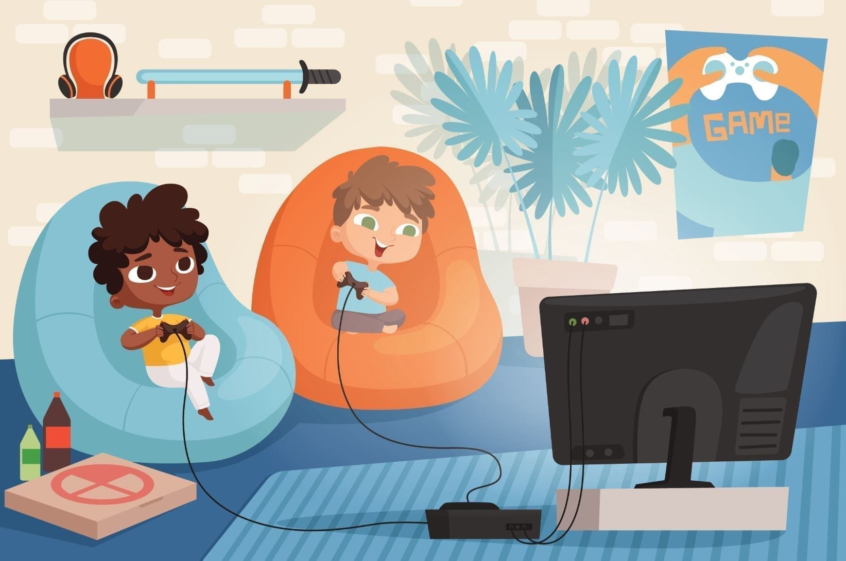
‘Video games should be banned for children.’
Sentence stems
Sentence stems

Slide 20
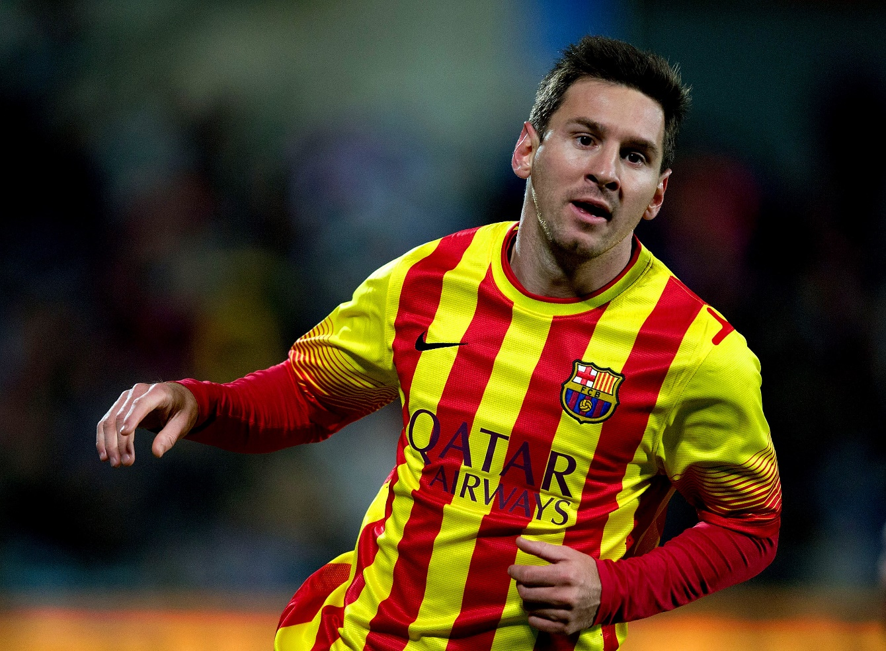
‘Footballers make too much money.’
Sentence stems

Slide 21
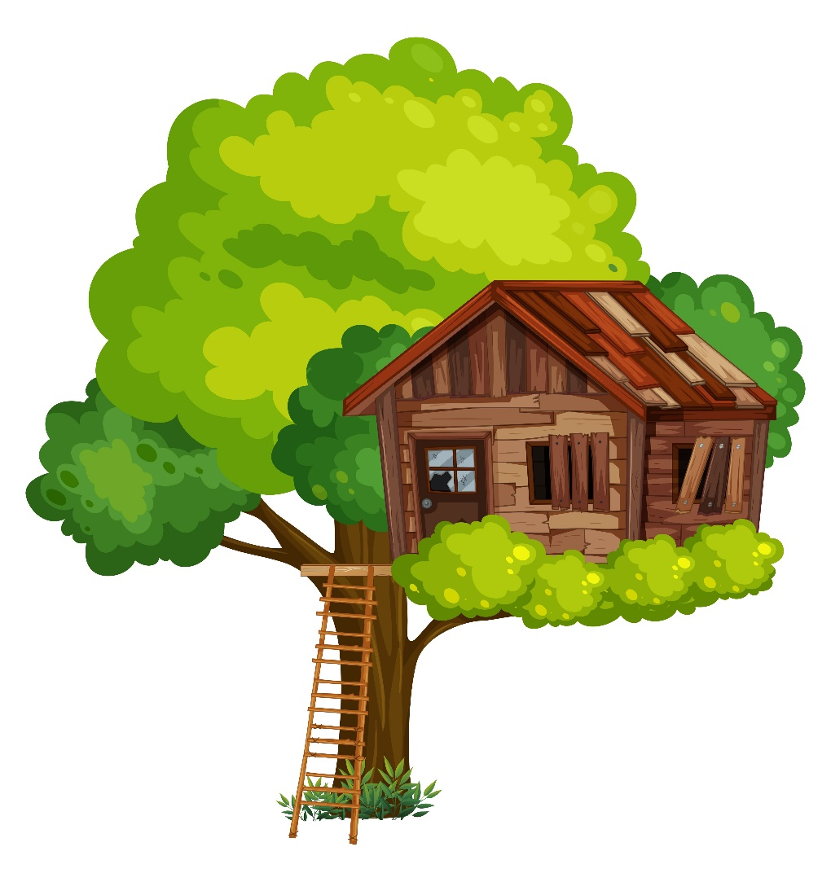
Would you rather live in a tree house or an igloo?
Sentence stems

Slide 22
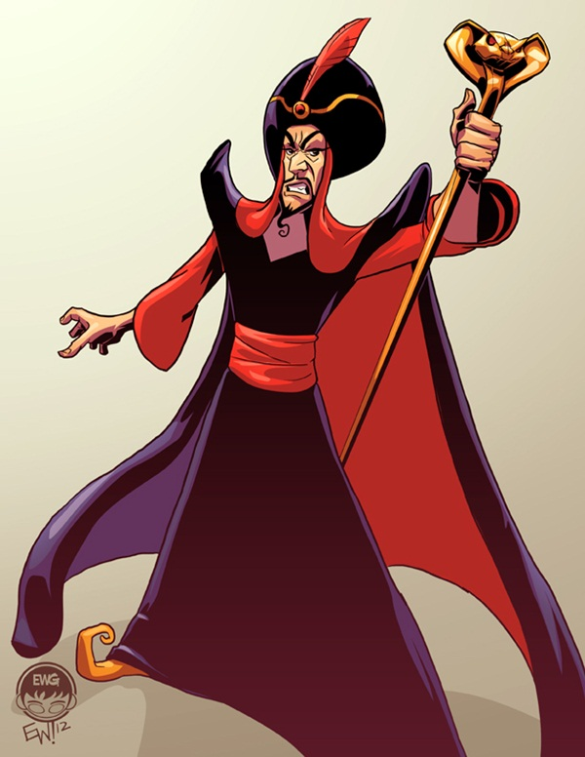
Would you rather be a hero or a villain?
Sentence stems
I would rather … because …

Slide 23
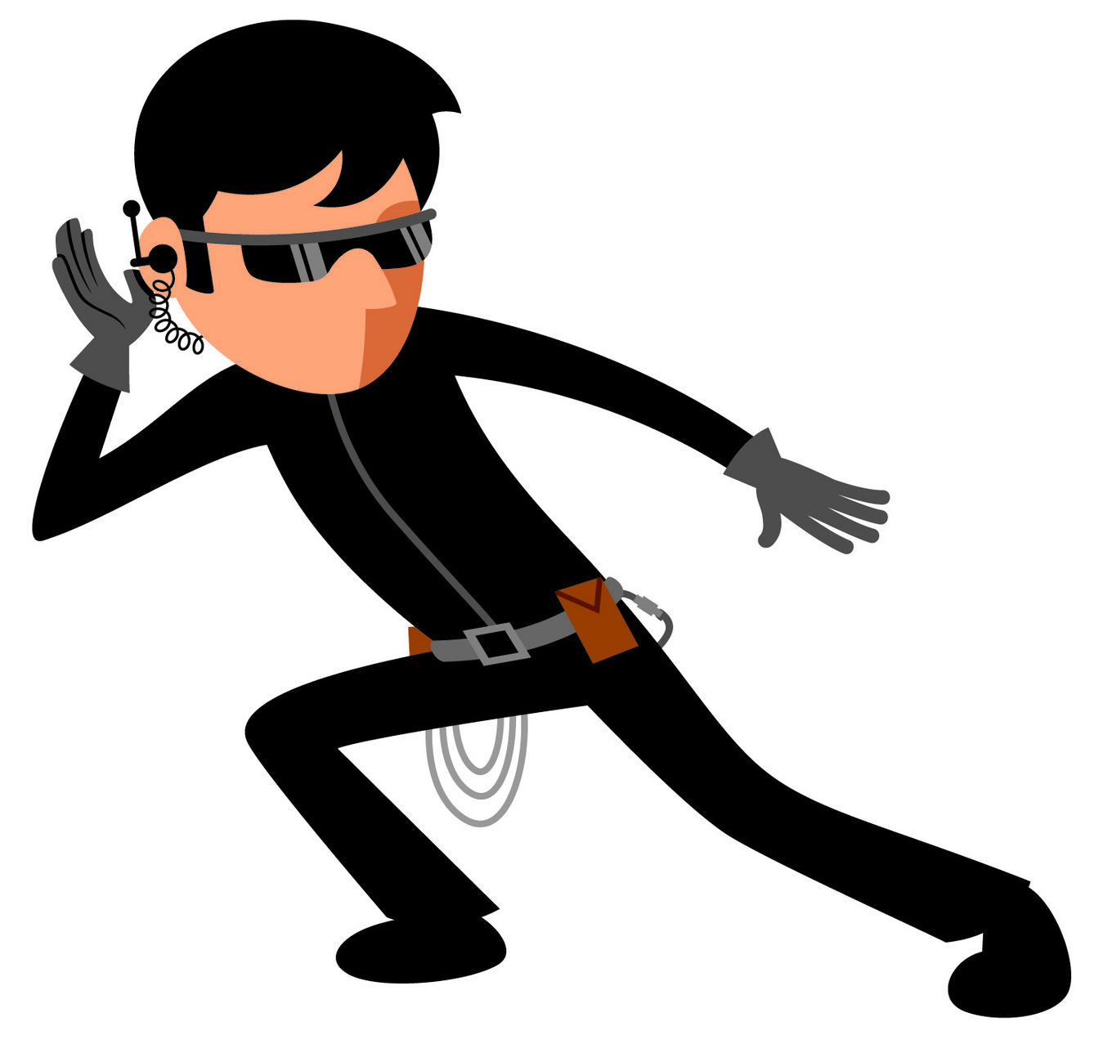
Would you rather be a spy or the prime minister?
Sentence stems

Slide 24
Would you rather have feet for hands or hands for feet?
Sentence stems

Slide 25
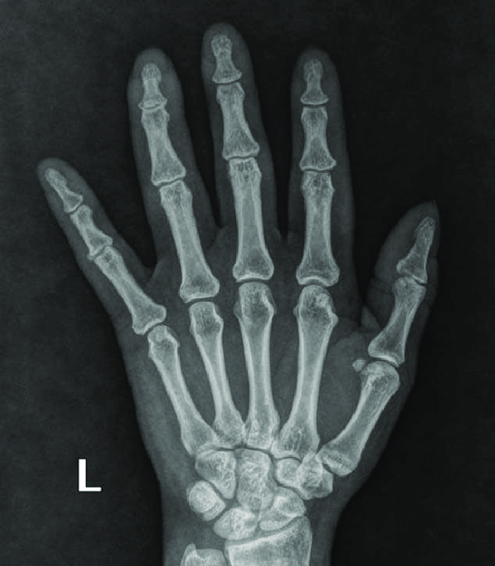
Would you rather have x-ray vision or supersonic hearing?
Sentence stems

Slide 26
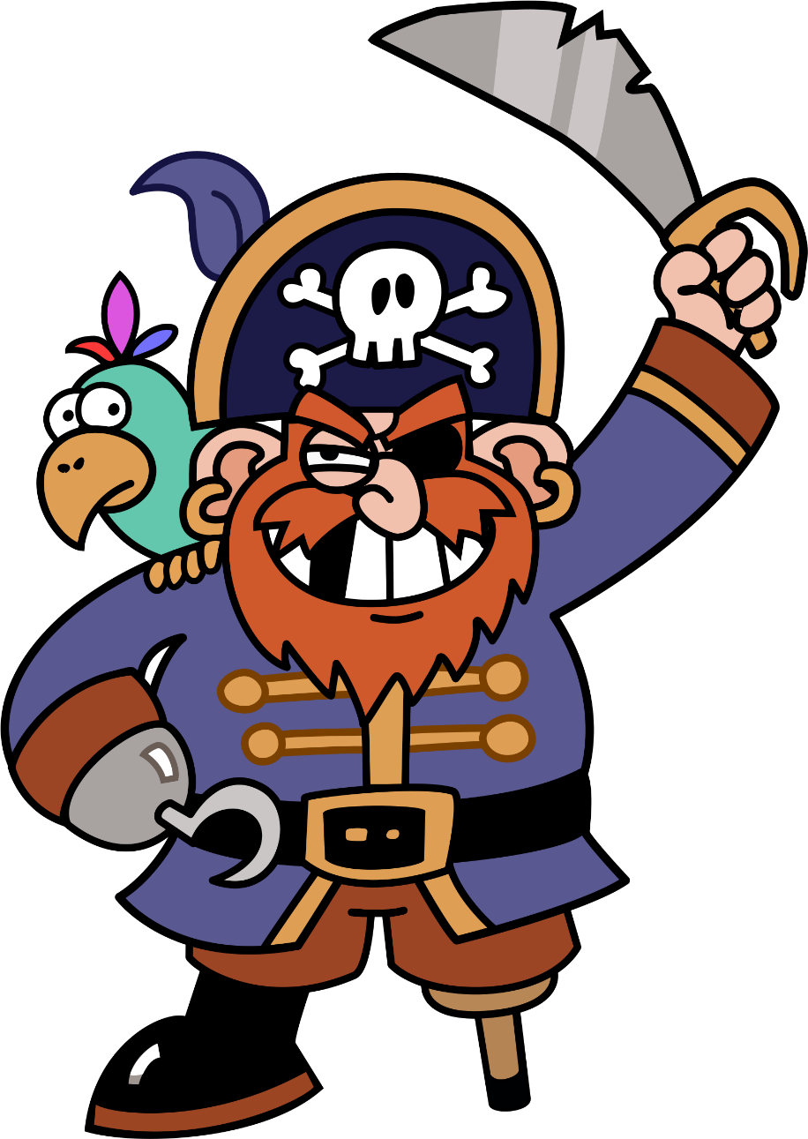
Would you rather be a pirate or ninja?
Sentence stems

Slide 27
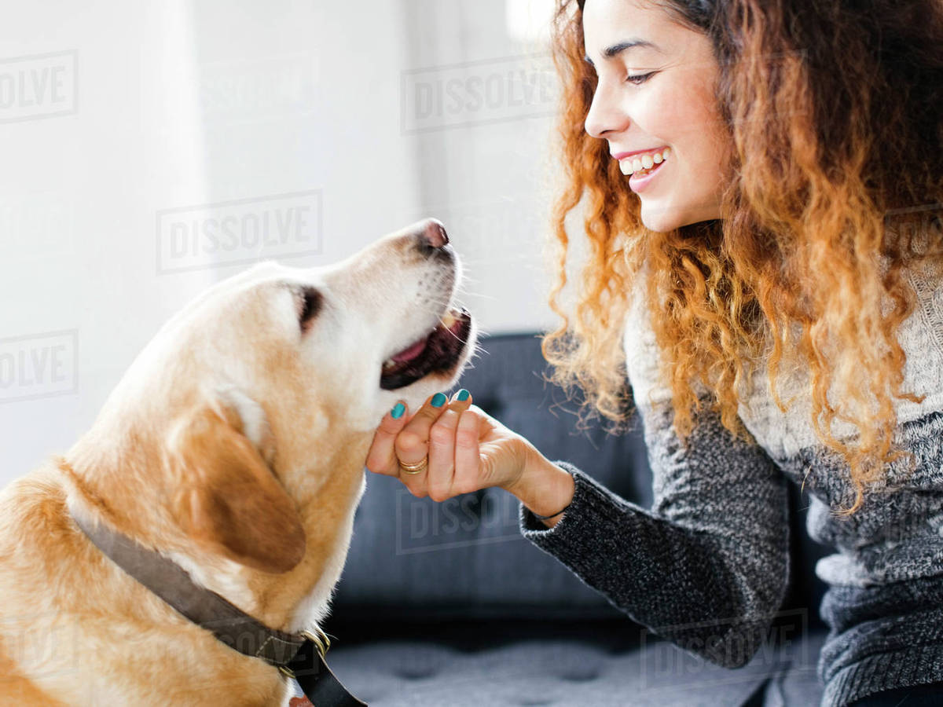
Does a dog mind what you stoke it with?
Sentence stems

Slide 28
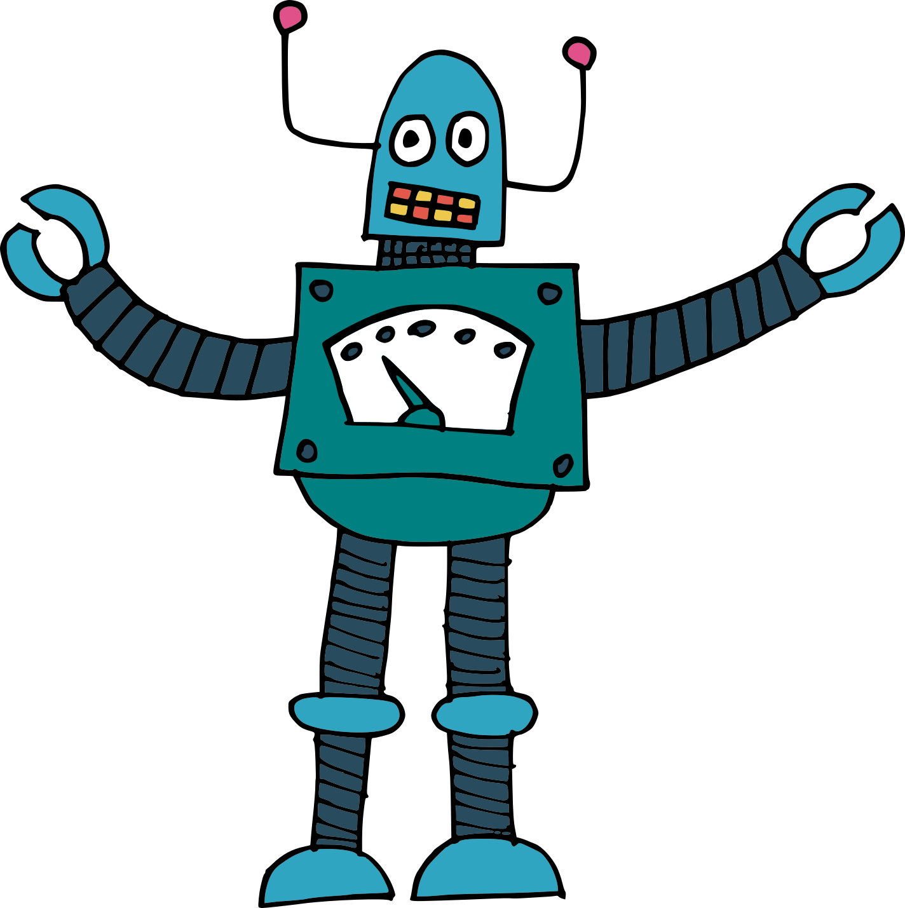
Should you say ‘thank you’ to a robot waiter?
Sentence stems

Slide 29
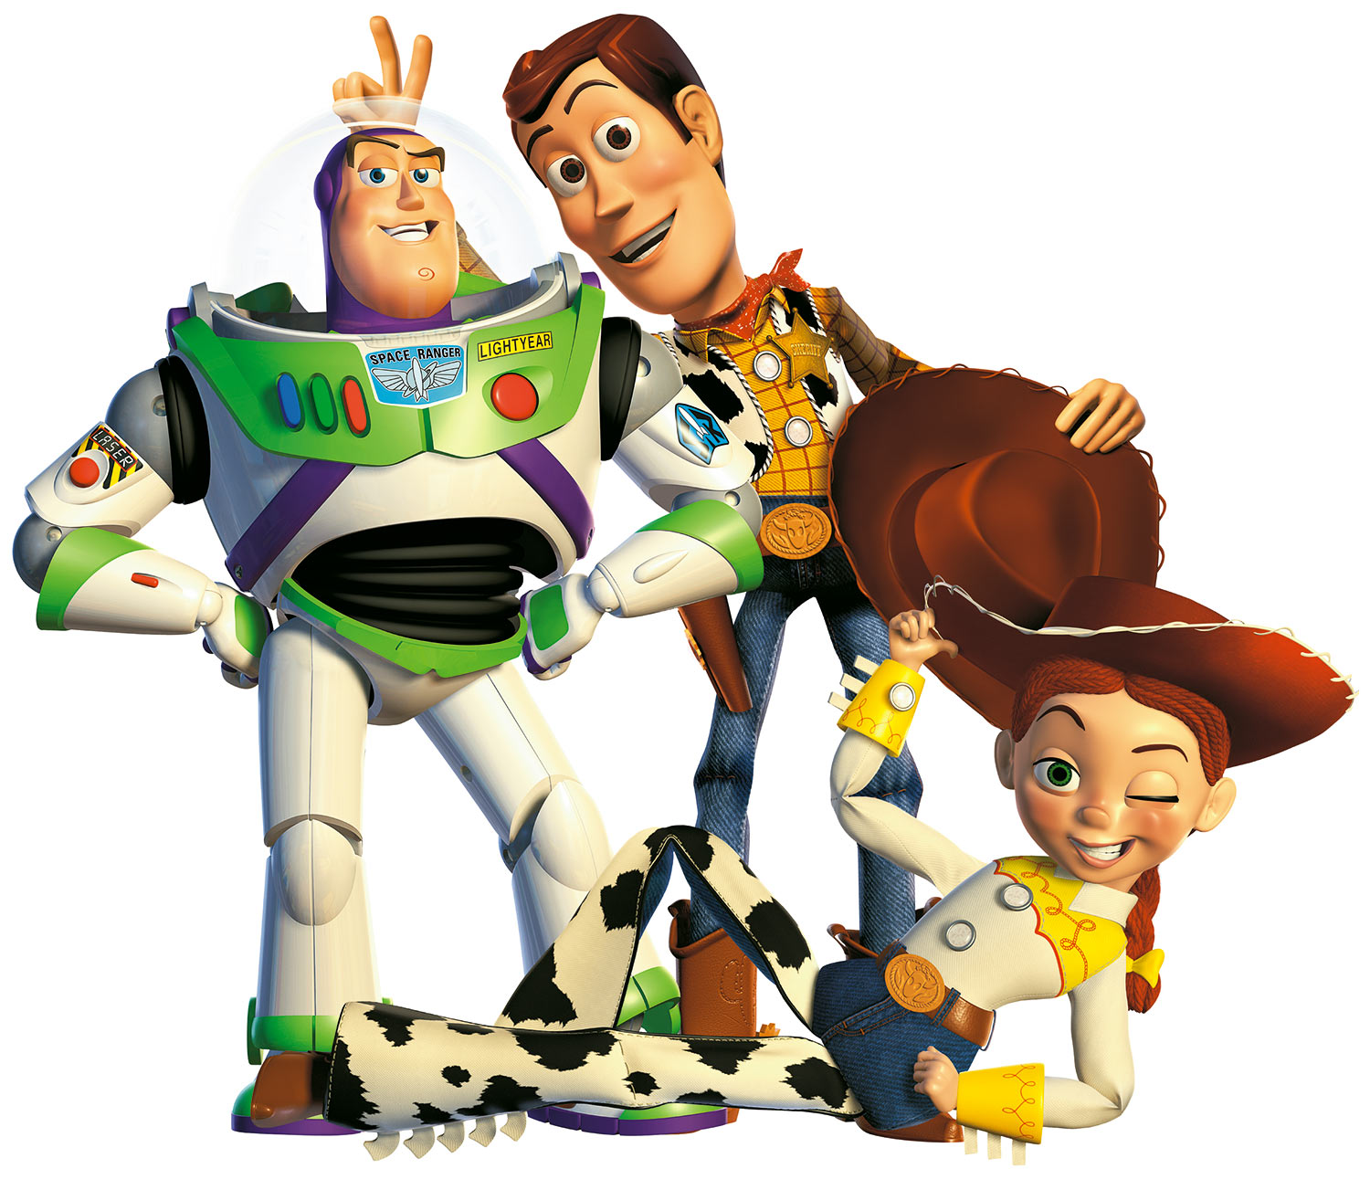
Can anything be a toy?
Sentence stems

Slide 30
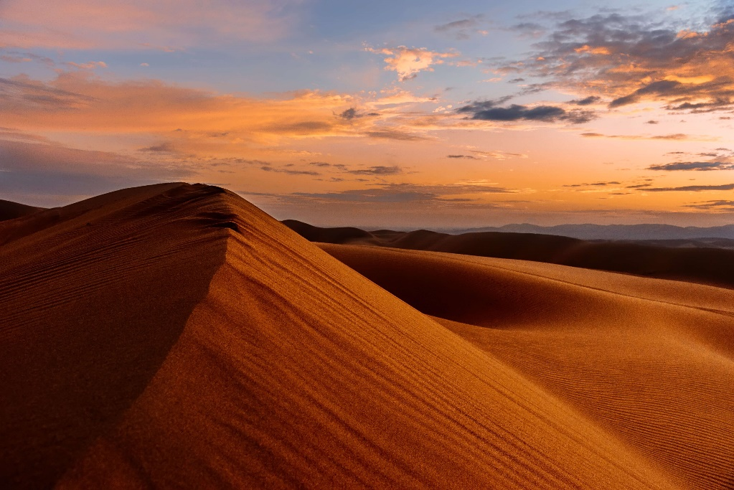
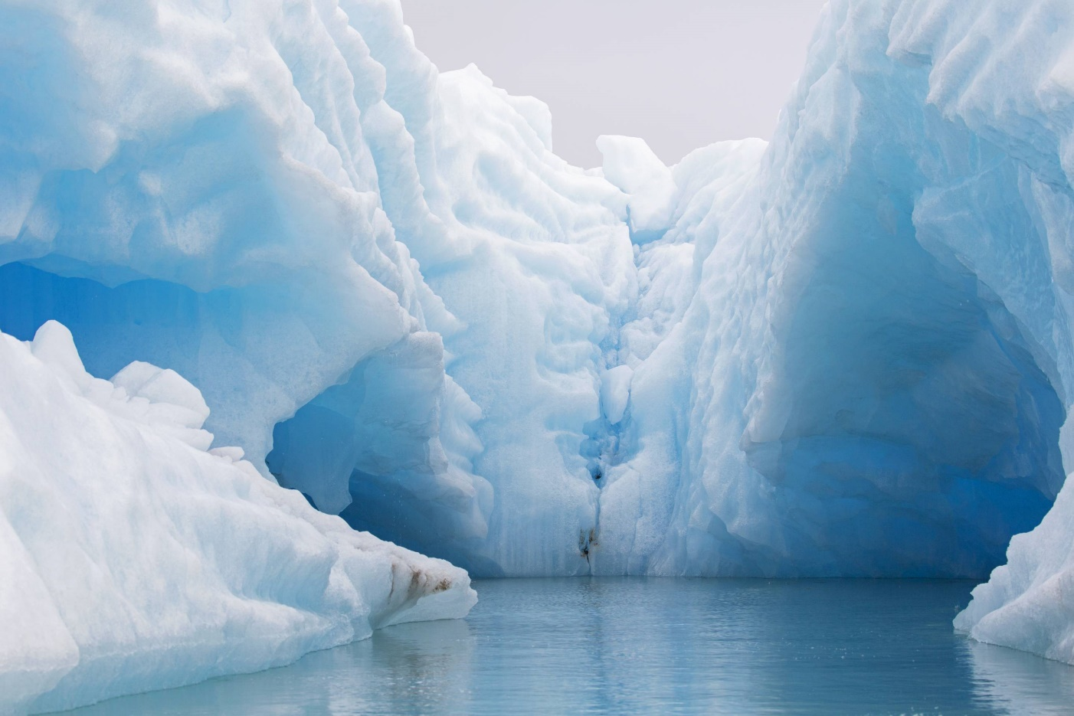
Would you rather live in the Arctic or live in the desert?
Sentence stems

Slide 31
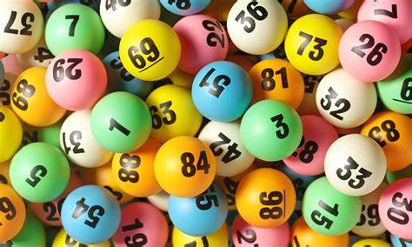
Would you rather win the lottery or have any superpower you wanted?
Sentence stems

Slide 32
Would you rather live without the TV or the internet?
Sentence stems

Slide 33
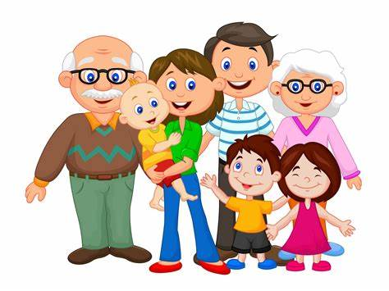
If you could swap places with one person in your family for a day, who would it be and why?
Sentence stems
The person I would swap with would be … because …
I love the way that they …
I admire them because ….
The quality that I most like about them is …
In addition, ….

Slide 34
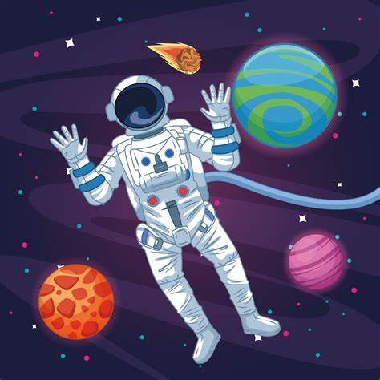
Would you rather be a pilot or astronaut?
Sentence stems

Slide 35
Should people care more about doing the right thing, or doing things right?
Sentence stems

Slide 36
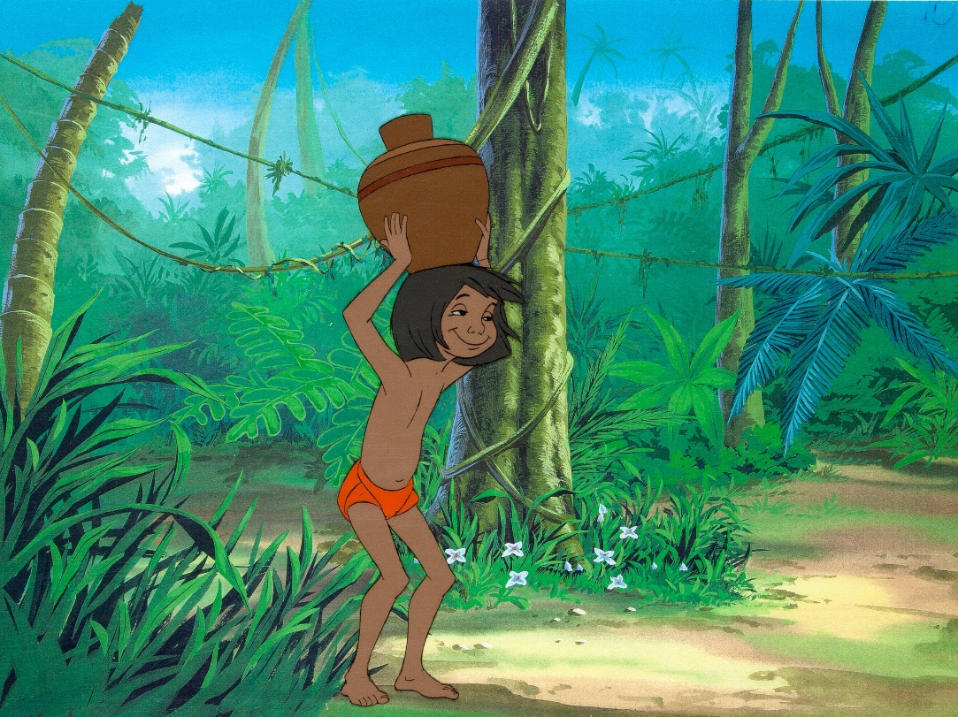
Would you rather go on an adventure with Moana or live in the jungle with Mowgli?
Sentence stems

Slide 37
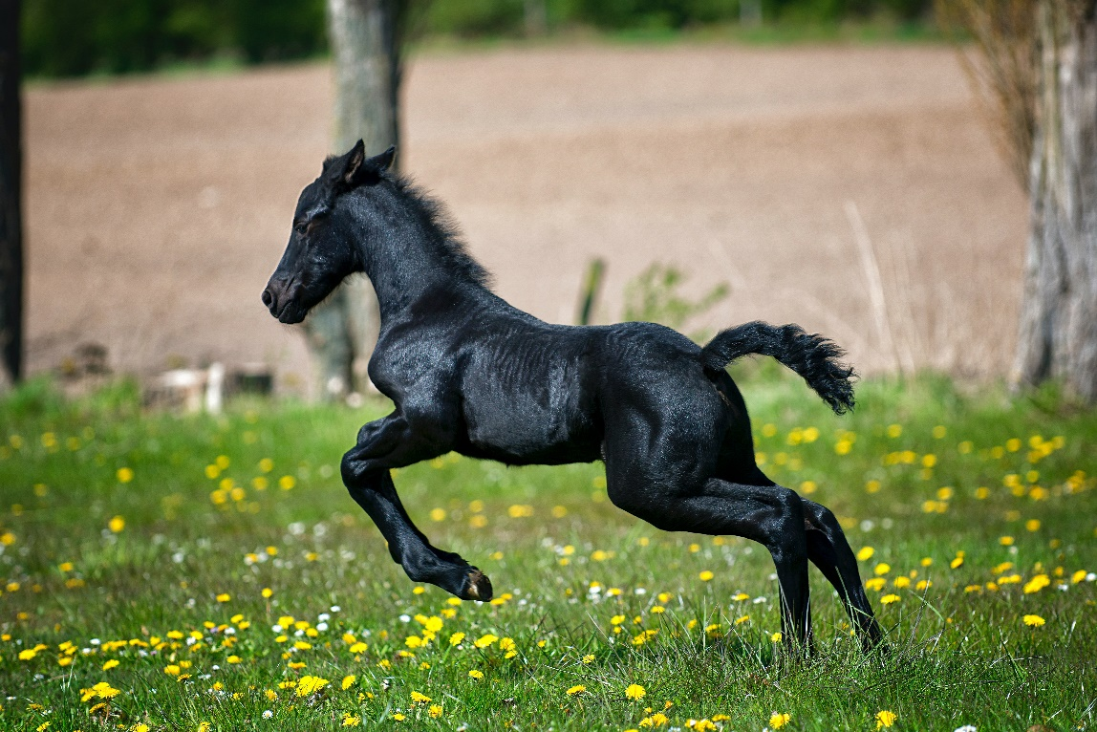
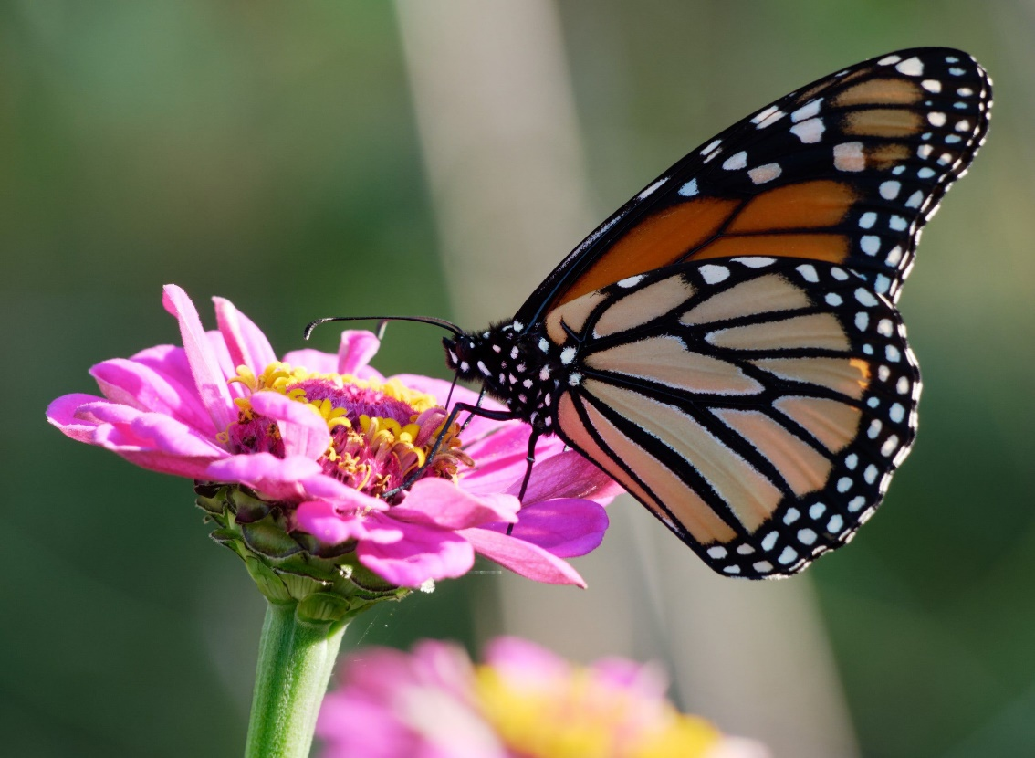
Who has more freedom – a horse or a butterfly?
Sentence stems

Slide 38
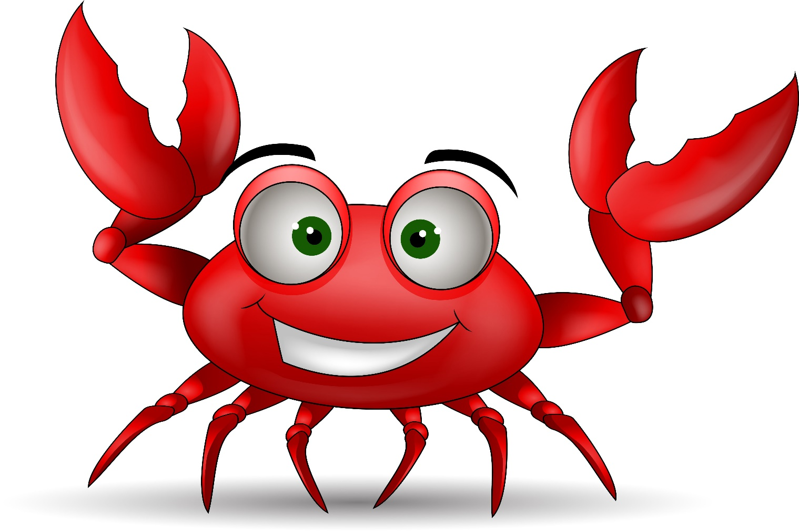
Would you rather only be able to walk on all fours or only be able to walk sideways like a crab?
Sentence stems

